Slide 1
CS676(73098) Algorihtms for Data Science Bhavik Mahavir Chopra(U01875744) Final Project Diabetes Prediction Modelling Onset

Slide 2
Content
Introduction
About data
Exploratory Data Analysis
Data Preprocessing
Machine Learning Methodologies
Model Comparison

Slide 3
- From MIDAS Q6.3, trying different values of k for maximum accuracy - Leveraged ML to predict & understand diabetes outcomes - Visualizing & standardizing data for reliable analysis. - Applied Supervised & Unsupervised ML methodologies - Compared the accuracies for better outcome
Introduction

Slide 4
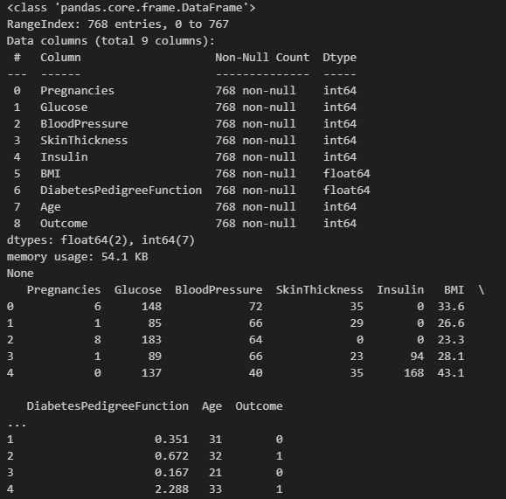
Reference: Kaggle(Diabetes Dataset) MIDAS Q6.3 Data & attributes:
About Data

Slide 5
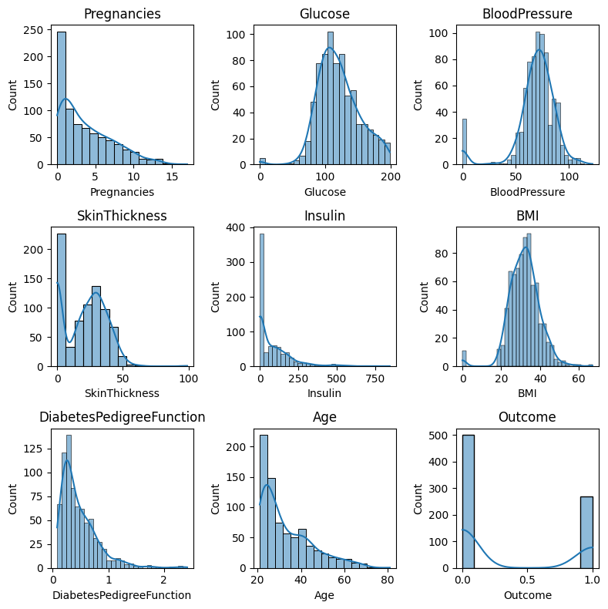
Exploratory Data Analysis
Distribution Analysis

Slide 6
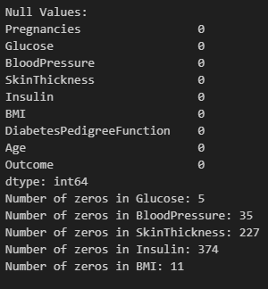
Missing Values & Zeros

Slide 7
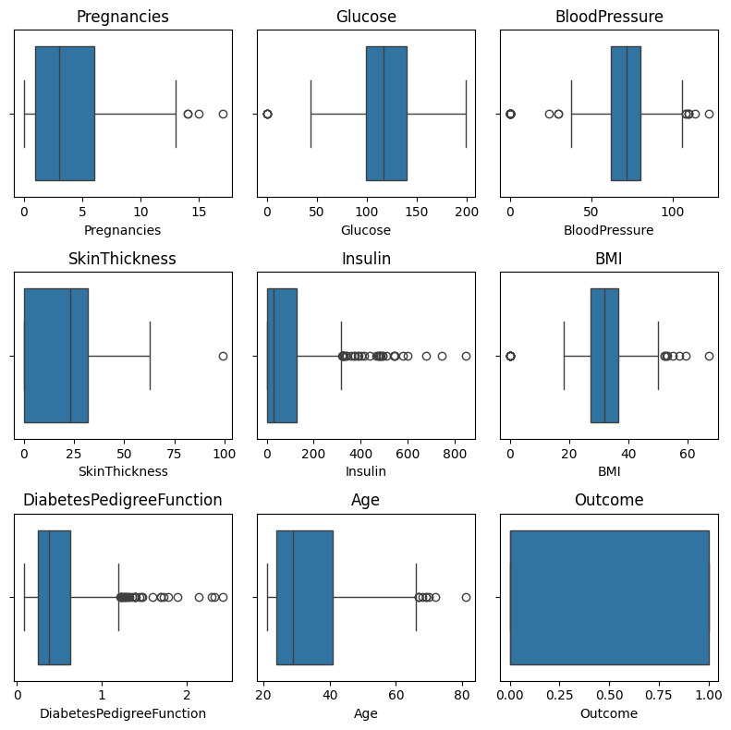
Outlier Detection

Slide 8
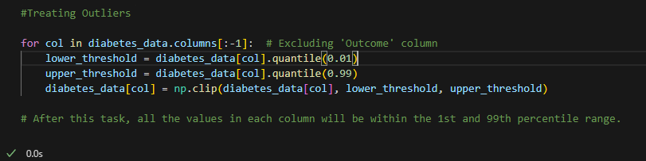
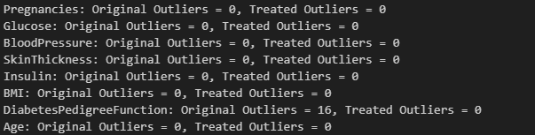
Treating Outliers
DiabetesPedigreeFunction column had 16 outliers

Slide 9
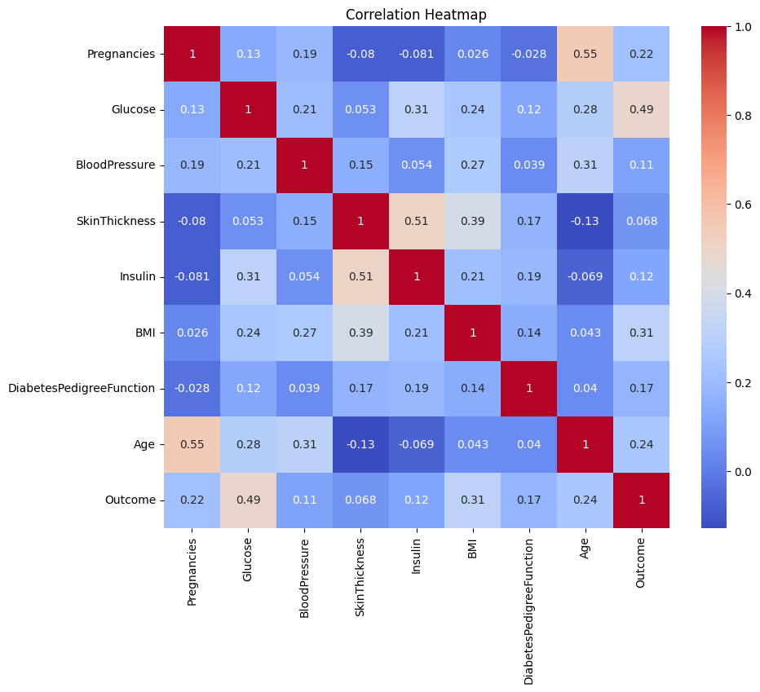
Correlation Analysis
Plotted Heatmap

Slide 10
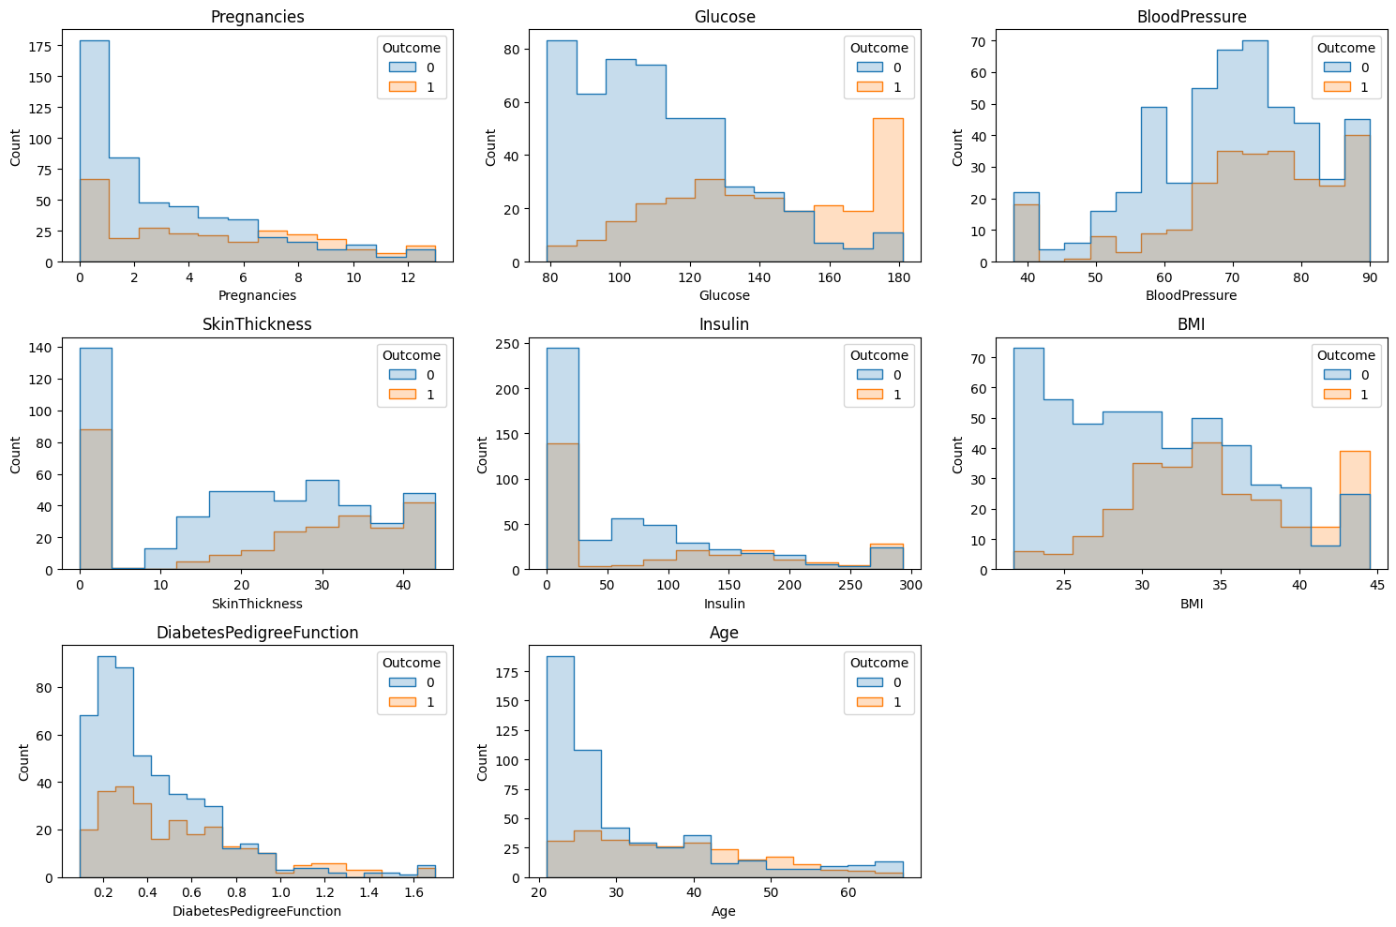
Comparing Groups (Diabetes vs. No Diabetes)
Plotted Histogram

Slide 11
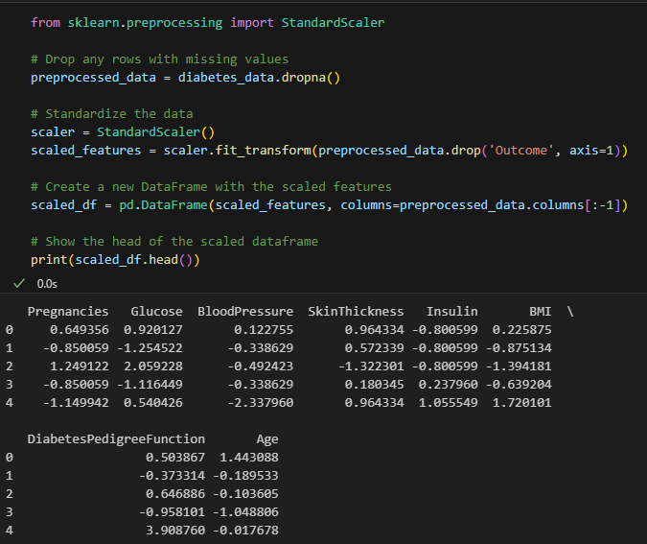
Data Preprocessing
Performed Standardization
Standardized Output

Slide 12
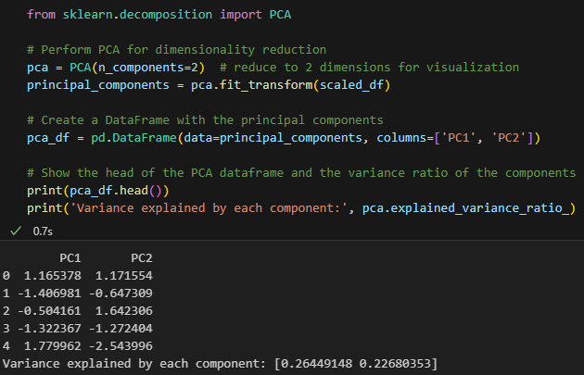
Feature Selection
- Performed Principal Component Analysis (PCA), reducing the dataset to two principal components.
- The variance explained by these components is approximately 26.18% and 21.64% respectively.

Slide 13
Machine Learning Methodologies
Logistic Regression
Random Forest
Fuzzy C- Mean Clustering
Supervised ML Models
Unsupervised ML Model
ML Models

Slide 14
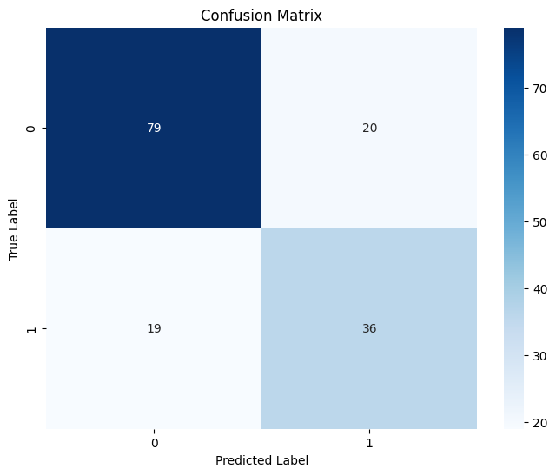
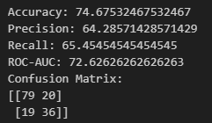
Logistic Regression

Slide 15
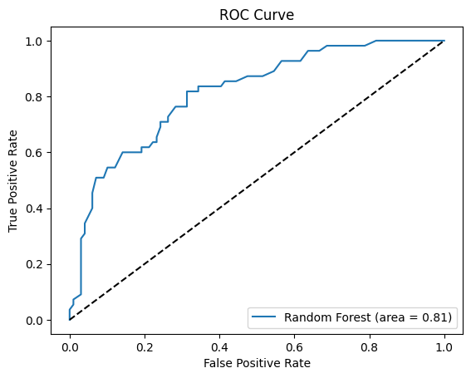
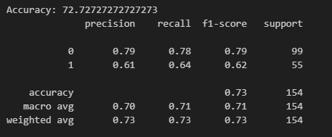
Random Forest

Slide 16
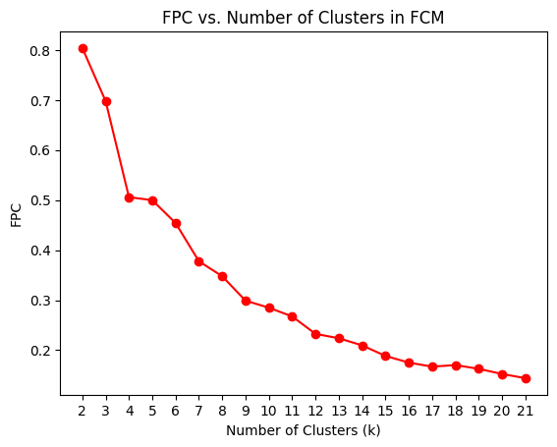
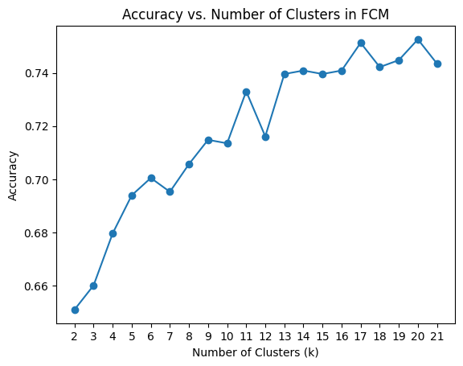

Fuzzy C-Mean Clustering

Slide 17
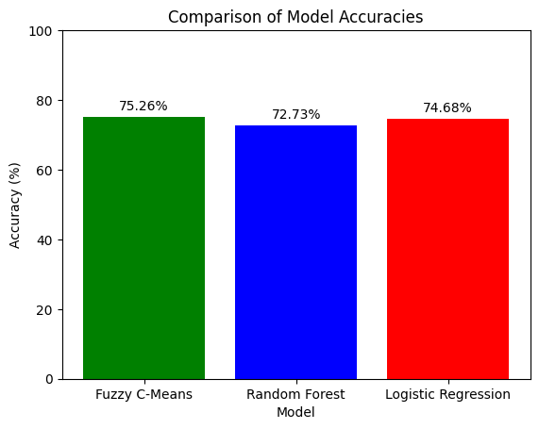
Model Comparison
Fuzzy C-Mean gives the maximum accuracy of 75.26%

Slide 18
Thank You!

